Slide 1
The importance of conscious awareness for understanding sentences.
Hugh Rabagliati
Alex Robertson
Dave Carmel
University of Edinburgh
Notes:
Thanks very much. This is joint work…

Slide 2
the rabbit that Elmer Fudd wants
Demands on working memory.
the rabbit that Elmer Fudd wants
the lady that Elmer Fudd wants
Access to broader world knowledge

Slide 3
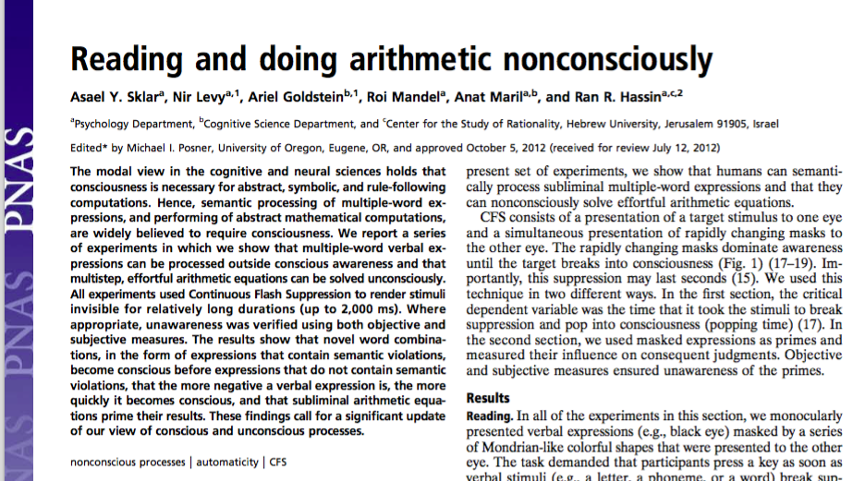
By Google Scholar, 120 citations (as of yesterday)

Slide 4
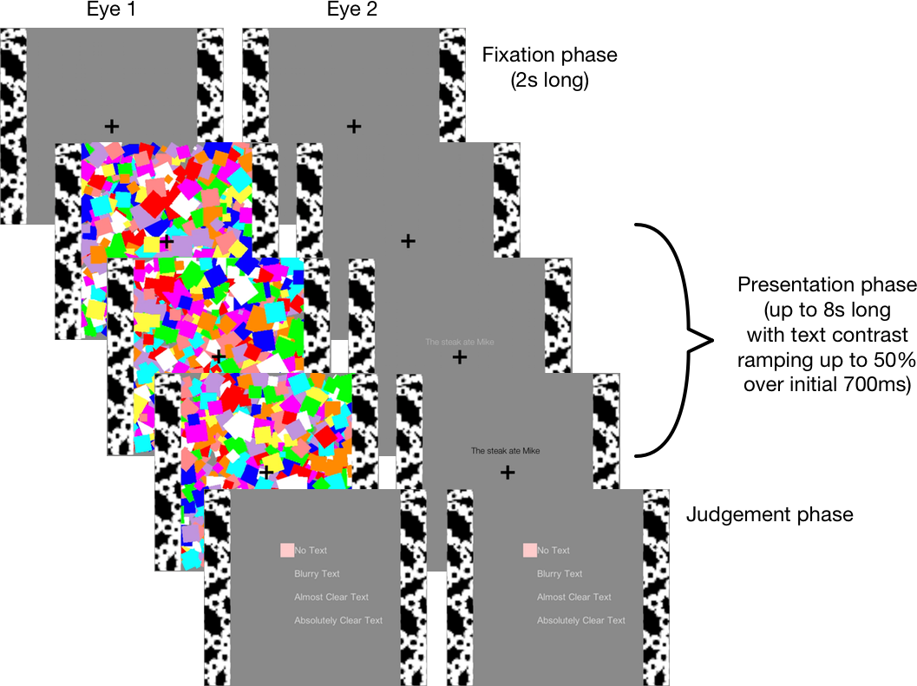
Breaking Continuous Flash Suppression
reaction time (ms)
reaction time (ms)
Violation
Control
-ve
+ve
I ironed the coffee
I ironed the shirt
stomach pump
paper clip
But in Hebrew.

Slide 5
Unconscious understanding?
Do these results replicate in English?
Do they survive more stringent controls?
reaction time (ms)
reaction time (ms)
Violation
Control
-ve
+ve
I ironed the coffee
I ironed the shirt
stomach pump
paper clip
Mike ate the steak
vs.
the steak ate Mike
the kitten chewed the lawnmower
vs.
the lawnmower chewed the kitten

Slide 6
Key Points
We conducted…
At least in English, we do not find reliable and robust evidence for unconscious combinatorial language processing.

Slide 7
Experiment 1
Expt 1a.
Replication of Sklar et al.’s Expt 1.
I ironed the coffee vs. I ironed the shirt
Expt 1b.
Reversible sentence extension of Sklar et al.’s Expt 1.
Mike ate the steak vs. the steak ate Mike
Sanity check.
Longer sentences break suppression faster.

Slide 8
Experiment 1
Indicate if sentence is above or below fixation.

Slide 9
Experiment 1
n = 53 (original n = 32)
stimuli presented on 19” CRT, via mirror stereoscope.
sentence stimulus ramped up from 0% to 50% contrast over 700ms.
mondrians alternated at 60Hz.
trials timed out after 8s.
perceptual rating scale followed each trial

Slide 10
1a. Sklar Replication
English translations of Sklar et al.’s original Hebrew stimuli.
34 Violation Sentences:
I ironed the coffee
68 Control Sentences:
I made the coffee
I ironed the clothes
reaction time (ms)
Violation
Control
1b. Reversible Sklar
Short English sentences whose meaning was nonsensical in reverse order.
150 Violation Sentences:
The steak ate Mike
150 Control Sentences:
Mike ate the steak
reaction time (ms)
Violation
Control

Slide 11
1a. Sklar Replication
English translations of Sklar et al.’s original Hebrew stimuli.
34 Violation Sentences:
I ironed the coffee
68 Control Sentences:
I made the coffee
I ironed the clothes
34 Filler sentences:
I bought the clothes
1b. Reversible Sklar
Short English sentences whose meaning was nonsensical in reverse order.
150 Violation Sentences:
The steak ate Mike
150 Control Sentences:
Mike ate the steak
Raw reaction times:
1a. Marg. Effect in wrong direction t(47) = 1.79, p=.08
1b. No effect t(47) = 0.02, p=.98

Slide 12
What lies beyond the bars?

Slide 13
Mixed Effects Generalized Linear Model from
Inverse Gaussian family
simulated data
glmer(rt ~ Violation + Length +
(1+ Violation | Subject) +
(1|Item),
family = inverse.gaussian)
1a. Sklar Replication
1b. Reversible Sklar
John ironed the coffee
the steak ate Mark
No effect violation:
B=0.006, t=0.6, p=.52
Longer stims break faster
B=-0.024, t=3.4, p<.001
No effect violation:
B=-0.002, t=0.4, p=.71
Longer stims break faster
B=-0.011, t=2.9, p<.01

Slide 14
Experiment 2
reaction time (ms)
Expt 2a.
Replication of Sklar et al.’s Expt 4.
stomach pump vs. hand rail
Expt 2b.
Reversible Sentence Extension of Sklar et al.’s Expt 4.
the kitten chewed the lawnmower vs. the lawnmower chewed the kitten
Sanity check.
Longer sentences break suppression faster.
-ve
+ve

Slide 15
Experiment 2
n = 73 (original n = 28)
stimuli presented on 19” CRT, via mirror stereoscope.
sentence stimulus ramped up from 0% to 50% contrast over 700ms.
mondrians alternated at 60Hz.
trials timed out after 8s.
perceptual rating scale followed each trial

Slide 16
2a. Sklar Replication
English translations of Sklar et al.’s original Hebrew stimuli, plus novel sentences.
50 sentences of varying affective ratings
reaction time (ms)
-ve
+ve
2b. Reversible Sklar
Short English sentences whose meaning was neutral/negative depending on order.
28 Neutral Sentences:
the kitten chewed the lawnmower
28 Negative Sentences:
the lawnmower chewed the kitten
reaction time (ms)
Negative
Neutral

Slide 17
2a. Sklar Replication
English translations of Sklar et al.’s original Hebrew stimuli, plus novel sentences.
50 sentences of varying affective ratings
Faster RTs for more neutral sentences (opposite from Sklar)
Standard Analysis: B = -0.018, t=1.5, p=.14
Inv-Gaussian Analysis: B = -0.018, t=1.6, p=.10
Length: B = -0.018, t=2.2, p=.02
2b. Reversible Sklar
No difference in RTs.
Standard Analysis:
B = -0.002, t=0.2, p=.82
Inv-Gaussian Analysis:
B = -0.002, t=0.2, p=.82
Length:
B = 0.018, t=2.7, p=.006
Short English sentences whose meaning was neutral/negative depending on order.
28 Neutral Sentences:
the kitten chewed the lawnmower
28 Negative Sentences:
the lawnmower chewed the kitten

Slide 18
Summary so far…
Sklar et al. found…
Combinatorial analyses of suppressed sentences.
Semantically unusual sentences break suppression faster.
Our findings so far…
2 large datasets.
Replication studies: Marginal effects in opposite direction – but not when analyzed with more appropriate stats.
Extension studies: No effect of semantics when surface features are controlled.
Sanity check: Longer stimuli break suppression faster.

Slide 19
How did our experiments differ?
Re-ran all of our experiments using Sklar et al’s original scripts (on English materials).
mondrians alternated at 60Hz. → 10 Hz
trials timed out after 8s. → 20s
perceptual rating scale followed each trial. → no PRS

Slide 20
1a.-r Sklar Replication
English translations of Sklar et al.’s original Hebrew stimuli.
34 Violation Sentences:
I ironed the coffee
68 Control Sentences:
I made the coffee
I ironed the clothes
reaction time (ms)
Violation
Control
1b.-r Reversible Sklar
Short English sentences whose meaning was nonsensical in reverse order.
150 Violation Sentences:
The steak ate Mike
150 Control Sentences:
Mike ate the steak
reaction time (ms)
Violation
Control

Slide 21
Experiment 1 replication
n = 74 (original n = 32)
stimuli presented on 19” CRT, via mirror stereoscope.
sentence stimulus ramped up from 0% to 50% contrast over 700ms.
mondrians alternated at 10Hz.
trials timed out after 20s.
No perceptual rating scale.

Slide 22
1a. Sklar Replication
1b. Reversible Sklar
Standard analysis:
Marginal effect violation
Inv-Gauss:
No effect violation
Longer stims break faster
Standard analysis:
No effect violation
Inv-Gauss:
No effect violation:
Longer stims break faster
1a-r. Sklar Replication
Standard analysis:
Effect violation (wrong direction): (t(61)=2.4,p=.02)
Inv-Gauss:
No effect violation: B = 0.016, t=1.4, p=.17
Longer stims break faster: B = -0.024, t=2.8, p<.01
1b-r. Reversible Sklar
Standard analysis:
No Effect violation: (t(61)=0.09,p=.93)
Inv-Gauss:
No effect violation: B = 0.0008, t=0.15, p=.88
Longer stims break faster: B = -0.016, t=4.2, p<.001

Slide 23
Emotional Experiment 2 replication
n = 74 (original n = 32)
stimuli presented on 19” CRT, via mirror stereoscope.
sentence stimulus ramped up from 0% to 50% contrast over 700ms.
mondrians alternated at 10Hz.
trials timed out after 20s.
No perceptual rating scale.

Slide 24
2a.-r Sklar Replication
English translations of Sklar et al.’s original Hebrew stimuli, plus novel sentences.
50 sentences of varying affective ratings (e.g., stomach pump)
reaction time (ms)
-ve
+ve
2b.-r Reversible Sklar
Short English sentences whose meaning was neutral/negative depending on order.
28 Neutral Sentences:
the kitten chewed the lawnmower
28 Negative Sentences:
the lawnmower chewed the kitten
reaction time (ms)
Violation
Control

Slide 25
2a. Sklar Replication
2b. Reversible Sklar
Standard analysis:
Marginal effect of emotion (wrong direction)
Inv-Gauss:
Marginal effect emotion
Longer stims break faster
Standard analysis:
No effect of emotion (wrong direction)
Inv-Gauss:
No effect emotion
Longer stims break slower (!)
2a-r. Sklar Replication
Standard analysis:
No Effect emotion: B = 0.02, t=0.9, p=.38
Inv-Gauss:
No effect violation: B = 0.007, t=0.4, p=.66
Longer stims break faster: B = -0.04, t=3.7, p<.001
2b-r. Reversible Sklar
Standard analysis:
Marginal Effect emotion: (t(63)=1.96,p=.05)
Inv-Gauss:
No effect violation: B = 0.016, t=0.99, p=.32
Longer stims break marg. faster: B = -0.019, t=1.7, p=.08

Slide 26
Summary
Expected
Direction
Unexpected
Direction
No effect
Round 1
(linear)
Rnd 1
(Inv-G)
Rnd 1
Length
Rnd 2
(linear)
Rnd 2
(Inv-G)
Rnd 2
Length
Sklar’s Nonsense Phrases
i ironed the coffee (102 items)
(marginal)
(p=.02)
Reversible Nonsense Phr.
the steak ate Mike (300 items)
Sklar’s Emotional Phrases
stomach pump (50 items)
Reversible Emo Phrases
the kitten chewed the lawnmower
(marginal)
(marginal)
(56 items)
No robust evidence for unconscious interpretation.
Marginal effects for low n conditions, esp. using ill-suited analysis methods.
Low power b-CFS effects are highly unstable.

Slide 27
Summary
No robust evidence for unconscious interpretation (in English).
Marginal effects for low n conditions, when using ill-suited analysis methods.
Low power b-CFS effects are highly unstable.
the rabbit that Elmer wants
Demands on working memory.
the rabbit that Elmer wants
the lady that Elmer wants
Access to broader world knowledge

Slide 28
Summary
Quote about amazingness of b-CFS.
No. b-CFS is a horrible and unstable method, with a nasty habit of producing false positives if analyzed using the standard suite of inferential statistics. Results are only robust with large numbers of items per participant.

Slide 29
Thank you to:
Ran Hassin Asael Sklar Ariel Goldstein
Notes:
Thanks for having me here, a psycholinguist entering unexplored waters

Slide 30
Many thanks to:

Slide 31
What is driving Sklar’s nonsense phrase effect?
p = .08
34 Violation Sentences:
I ironed the coffee
68 Control Sentences:
I made the coffee
Simulated 1000 null experiments using skew t distribution.
Applied Sklar et al’s exclusion criteria.
p = .02
False positive rate ~ 0.15 (1 in 7 chance of a significant result).
Almost 1 in 4 chance of a marginal result.

Slide 32
Are RTs still skewed when averaged?
Yes.

